Slide 1
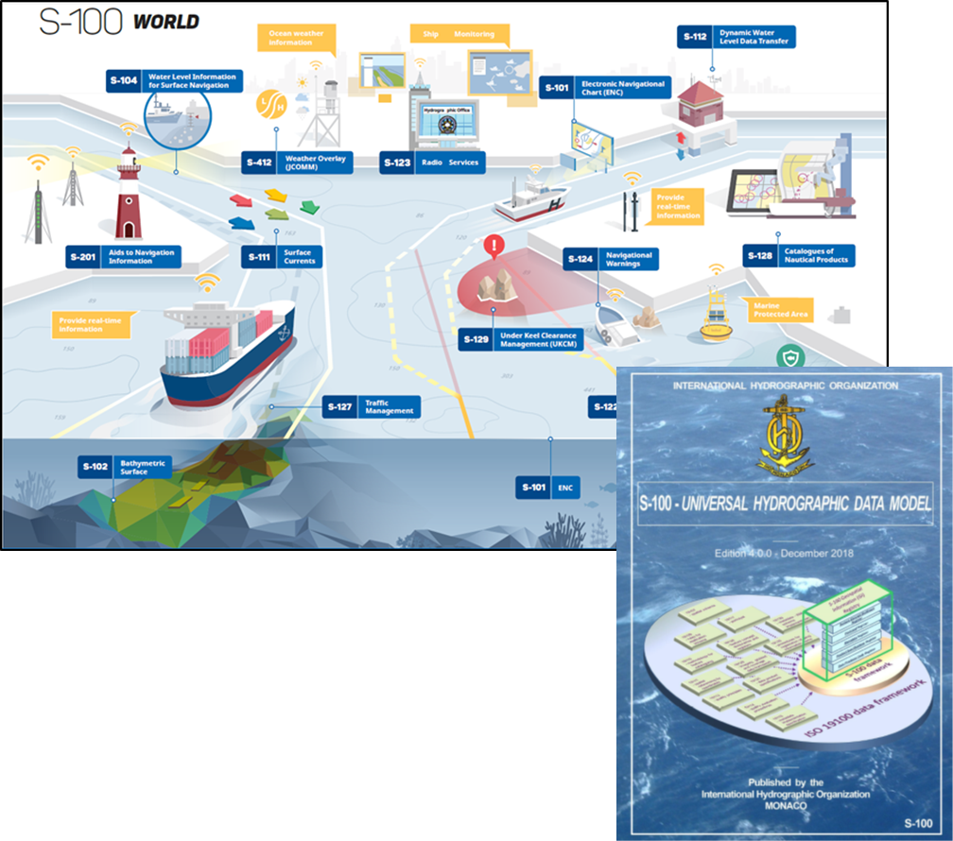
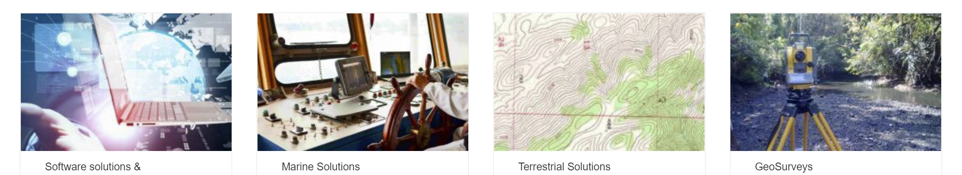

IIC Technologies
IIC Technologies provides solutions and services for the acquisition, management, integration and dissemination of geospatial data.
Global Presence – Clients in over 30 countries
End-to-end geospatial solutions to the Aeronautics, Defense, Government, Infrastructure, Marine, Oil & Gas, Transportation and Utility sectors.
Marine Sector.
Production of Marine Charts and publications data for Navigation
Consultants on international standards for hydrography with over 25 years experience in pioneering digital navigation
Senior Consultants specializing in modelling, development, data production and cross-sectoral integration.
Notes:
Our Senior consultant for the testbed project is Jonathan Pritchard. Jonathan has over 20 years experience in the geospatial industries and over 30 years experience in the technology sector. Via cryptography and the telecommunication industry, Jonathan joined IIC Technologies from the United Kingdom Hydrographic Office, one of the foremost marine geospatial mapping agency in the world. He has over 20 years experience within geospatial standards working groups in the International Hydrographic Organization and is one of the current founding co-chairs of the OGC’s Marine Domain Working Group. He carries out development and consulting work in a wide variety of fields concerning marine geospatial data across the IHO, ISO and Un-GGIM groups. He was technical lead for the OGC’s Maritime Limits and boundaries Pilot Project, where the foundations of integration between the IHO’s S-100 framework and OGC web services were laid.

Slide 2
“Using the IHO’s S-100 framework as a representation of data content and modelling, execute an OGC API reference implementation of S-100 metadata and S-128 content for advanced dataset discovery”
The objectives of the research are:
Demonstrate how IHO S-100 marine data can be discovered using existing OGC API Records methodologies and the ISO 19115 metadata embedded in S-100 datasets and service discovery metadata within ISO S-128.
Setup a testbed for a region with multiple S-100 datasets and service definitions in S-128 and provide dataset discoverability services using OGC API methodologies.
Feedback to the OGC community, primarily through OGC MDWG, and IHO and through the upcoming revision to S-100 (edition 5.0.0) on any modifications to the standards base to more easily enable interoperability between the two frameworks.
Produce a documented initial approach detailing how the discoverability elements can be used as a prototype to develop full OGC/IHO interoperability and the potential for such interoperability.

Slide 3
The approach
The objective is to make IHO marine geospatial metadata available through OGC API Records
OGC API Records (draft) is an extension of OGC API Common with metadata specific elements within the API structure.
What is metadata? It’s “data about data”
OGC reflects this by making the API methodology for describing metadata (records) an extension of the API for data content itself…
data
about
data
IHO Standards don’t do it this way…
Metadata is encoded in XML using ISO templates (for 19115)
Data Content is modelled using the S-100 General Feature Model and described using S-100’s Feature Catalogue (XML)
They’re both XML but stem from different models.

Slide 4
The approach
The objective is to make metadata available through OGC API Records
OGC API Records (draft) is an extension of OGC API Common with metadata specific elements within the API structure.
OGC reflects this by making the API methodology for describing metadata (records) an extension of the API for data content itself…
What is metadata? It’s “data about data”
data
about
data
IHO Standards don’t do it this way…
Metadata is encoded in XML using ISO templates (for 19115)
Data Content is modelled using the S-100 General Feature Model and described using S-100’s Feature Catalogue (XML)
They’re both XML but stem from different models.

Slide 5
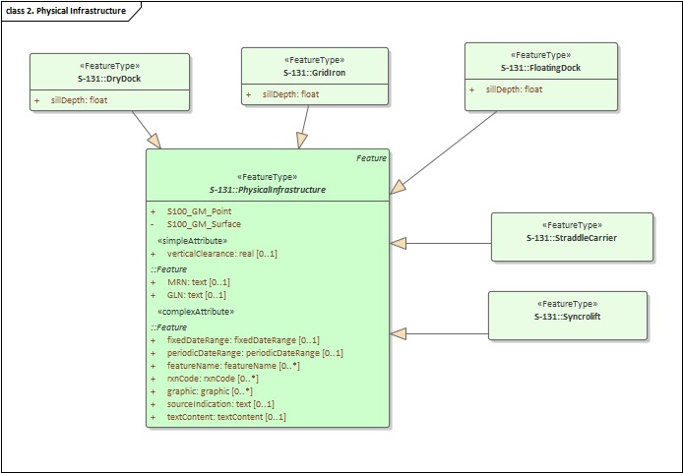
Defining Data in IHO S-100
Data structures are defined using a restricted set of UML primitives (defined in the framework) and building an application schema.
Then a Feature Catalogue is (manually) built from the Application Schema
The Feature Catalogue is then used to define datasets which conform to the feature catalogue.
Encodings can be either raster (HDF5) or Vector (ISO8211 or GML)
Each product specification can extend the generic metadata with their own fields by extending the generic S-100 metadata XML Schema
Examples:
S-101 – electronic charts
S-102 – Dense Bathymettry
S-127 – Vessel Traffic Management
Model
<S100FC:S100_FC_FeatureCatalogue xmlns:S100Base="http://www.iho.int/S100Base" <S100FC:name>Feature Catalogue for S-127</S100FC:name> <S100FC:scope>Global coverage of maritime areas</S100FC:scope> <S100FC:fieldOfApplication>Marine Traffic Management</S100FC:fieldOfApplication> <S100FC:versionNumber>1.0.0-20181129</S100FC:versionNumber> <S100FC:versionDate>2018-11-29</S100FC:versionDate> <S100FC:producer> <S100CI:role>publisher</S100CI:role> <S100CI:party> <S100CI:CI_Organisation> <S100CI:name>International Hydrographic Organization</S100CI:name> <S100CI:contactInfo> <S100CI:address> <S100CI:deliveryPoint>International Hydrographic Organization, 4 quai Antoine 1er, B.P. 445</S100CI:deliveryPoint> <S100CI:postalCode>MC 98011 MONACO CEDEX</S100CI:postalCode> </S100CI:address> <S100CI:contactInstructions>Contact IHO NIPWG Chair</S100CI:contactInstructions> </S100CI:contactInfo> </S100CI:CI_Organisation> </S100CI:party> </S100FC:producer> <S100FC:classification>unclassified</S100FC:classification> <S100FC:S100_FC_SimpleAttributes> <S100FC:S100_FC_SimpleAttribute> <S100FC:name>Administrative Division</S100FC:name> <S100FC:definition>Administrative division is a generic term for an administrative region within a country at a level below that of the sovereign state.</S100FC:definition> <S100FC:code>administrativeDivision</S100FC:code> <S100FC:valueType>text</S100FC:valueType> </S100FC:S100_FC_SimpleAttribute>
Feature Catalogue

Slide 6
= derived from
API metadata
API data
API
data
Feature Catalogue
GML Schema
Model
metadata
Metadata
(+)
Extension
?
metadata
(metadata)
Feature Catalogue
Metadata
Model

Slide 7
METADATA
So a slightly different approach for metadata is to model it using the S-100 general feature model
Use the same data modelling approach for metadata as data
But use OGC Records API “attributes” and sub-attributes
Then we can make metadata as an extension of S-100 data
Conforms to S-100 GFM
“native types”
Similar to OGC API philosophy
This is (sort of) what IHO S-128 does…
metadata
(metadata)
Feature Catalogue
Metadata
Model

Slide 8
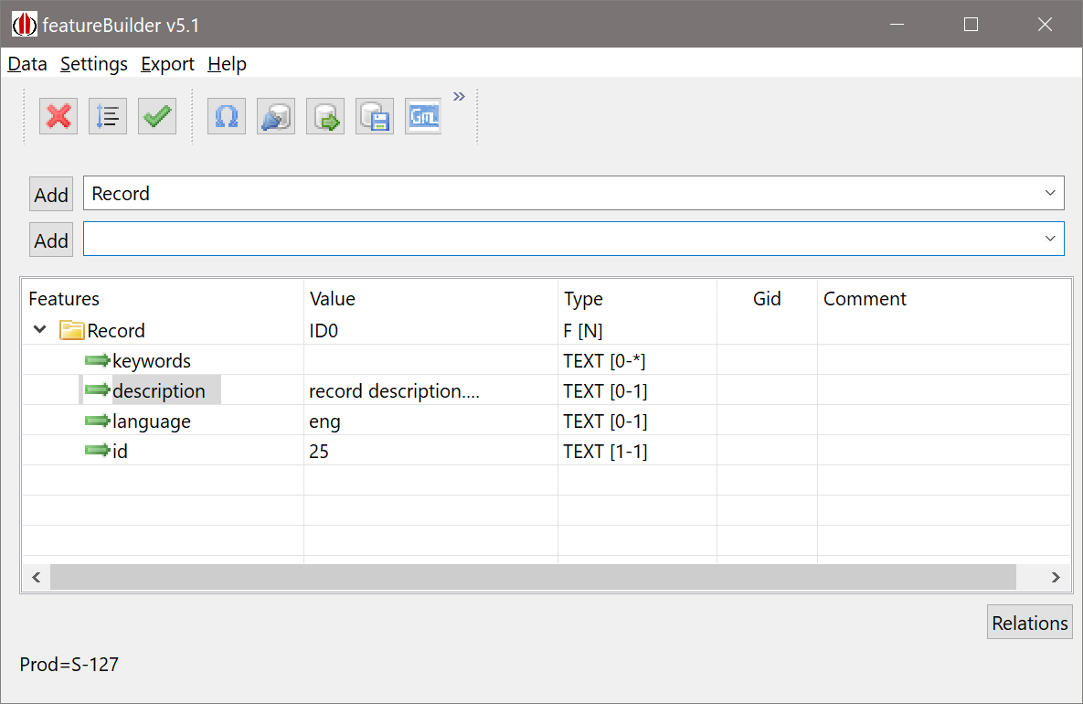
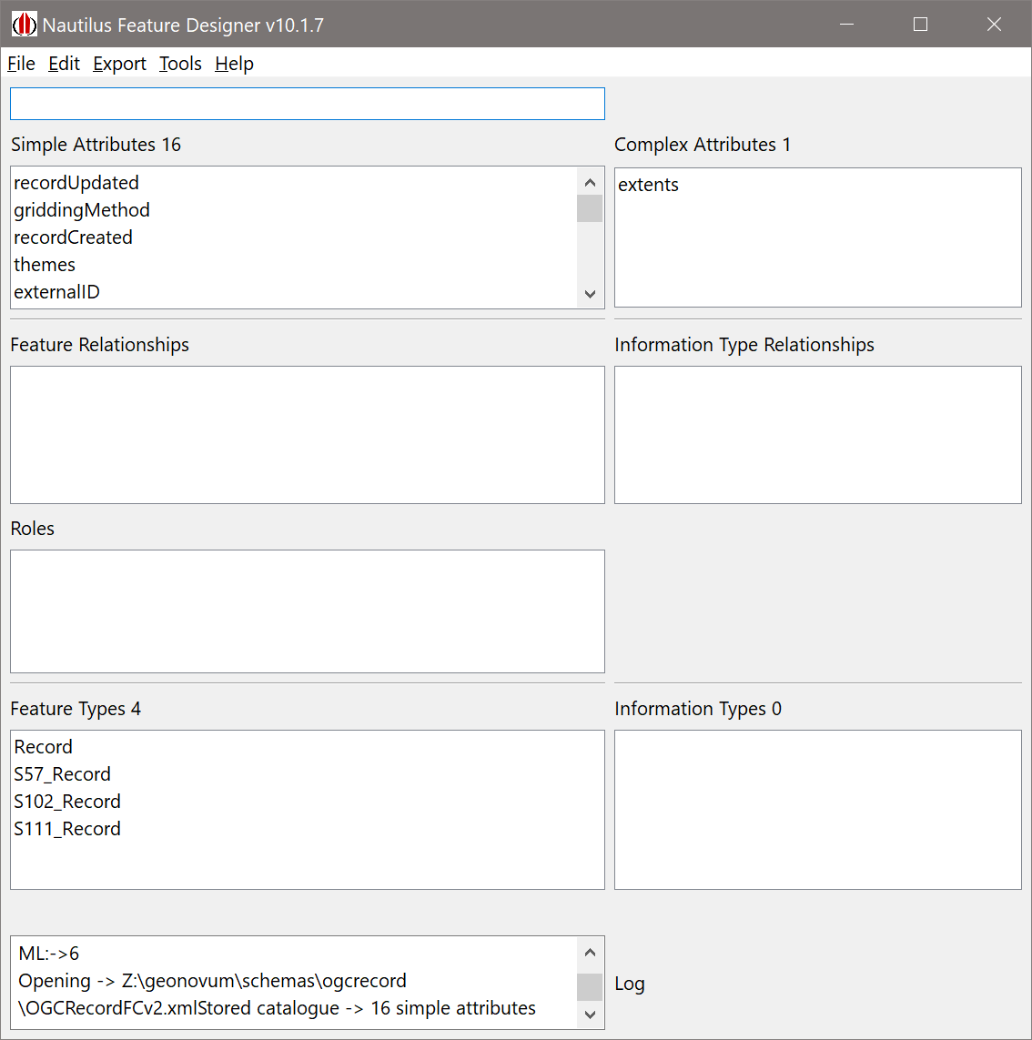
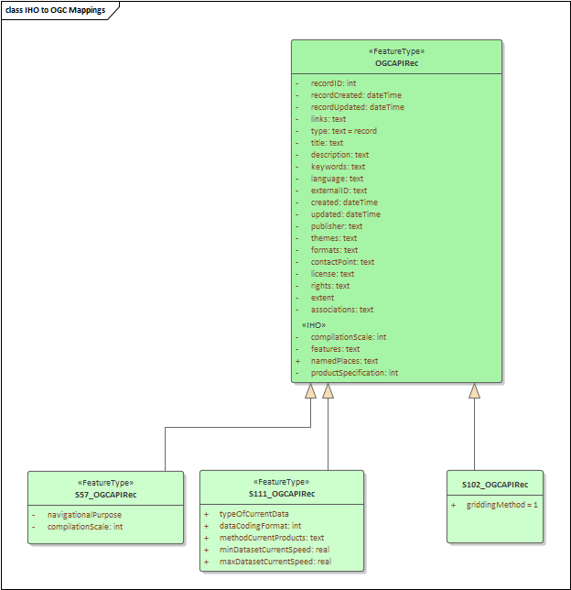
<S100FC:name>OGCRecordsFC</S100FC:name> <S100FC:scope>global</S100FC:scope> <S100FC:fieldOfApplication>none</S100FC:fieldOfApplication> <S100FC:versionNumber>0.0</S100FC:versionNumber> <S100FC:versionDate>2021-10-29+01:00</S100FC:versionDate> <S100FC:producer> <S100CI:role>author</S100CI:role> <S100CI:party> <S100CI:CI_Organisation> <S100CI:name>None</S100CI:name> <S100CI:contactInfo> <S100CI:address> <S100CI:city>Frome</S100CI:city> <S100CI:administrativeArea>Somerset</S100CI:administrativeArea> <S100CI:country>UK</S100CI:country> <S100CI:electronicMailAddress>jp@jpsworldoffun.com</S100CI:electronicMailAddress> </S100CI:address> <S100CI:onlineResource> <S100CI:linkage>www.iictechnologies.com</S100CI:linkage> </S100CI:onlineResource> </S100CI:contactInfo> </S100CI:CI_Organisation> </S100CI:party> </S100FC:producer> <S100FC:classification>unclassified</S100FC:classification> <S100FC:S100_FC_SimpleAttributes> <S100FC:S100_FC_SimpleAttribute> <S100FC:name>recordUpdated</S100FC:name> <S100FC:definition>recordUpdated</S100FC:definition> <S100FC:code>recordUpdated</S100FC:code> <S100FC:alias></S100FC:alias> <S100FC:valueType>dateTime</S100FC:valueType> </S100FC:S100_FC_SimpleAttribute> <S100FC:S100_FC_SimpleAttribute> <S100FC:name>griddingMethod</S100FC:name> <S100FC:definition>griddingMethod, used for S-102 grid data</S100FC:definition> <S100FC:code>griddingMethod</S100FC:code> <S100FC:alias></S100FC:alias> <S100FC:valueType>enumeration</S100FC:valueType> <S100FC:listedValues> <S100FC:listedValue> <S100FC:label>historicalObservation</S100FC:label> <S100FC:definition>historicalObservation - from S-102 Product Specifcation</S100FC:definition> <S100FC:code>1</S100FC:code> </S100FC:listedValue> <S100FC:listedValue> <S100FC:label>realtimeObservation</S100FC:label> <S100FC:definition>realtimeObservation</S100FC:definition> <S100FC:code>2</S100FC:code> </S100FC:listedValue>
geoj.append(",\"geometry\": { \"type\": \"Polygon\", \"coordinates\": [[["). append(wlon).append(",").append(nlat).append(" ] "). append(", [").append(elon).append(" , ").append(nlat).append("] , ["). append(elon).append(" , ").append(slat).append("], ["). append(wlon).append(" , ").append(slat).append("], ["). append(wlon).append(",").append(nlat). append("]]]}"); geomap.put(nm , geoj.toString()); geo = "st_geomfromtext('" + geo + "')"; geo = "st_setsrid(" + geo + ",4326)"; String stmt2 = " values(" + "'" + nm + "'," + "'" + base_isdt + "'," + edtn + "," + "'" + upd + "'," + updn + "," + sz + "," + geoj.toString() + "," + u + ")"; int t = T.getNextFeatureID(); ArrayList<treenod2> nds = new ArrayList<treenod2>(){ { add(new treenod2(1, 0, 0, t, "typeOfProductFormat", "ISO/IEC 8211", "sA")); add(new treenod2(2, 0, 0, t, "chartNumber", nm, "sA")); add(new treenod2(3, 0, 0, t, "compilationScale", "45000", "sA")); add(new treenod2(4, 0, 0, t, "producerCode", nm.substring(0, 2), "sA")); add(new treenod2(5, 0, 0, t, "copyright", "not applicable", "sA")); add(new treenod2(6, 0, 0, t, "editionDate", "2019-04-05", "sA")); add(new treenod2(7, 0, 0, t, "editionNumber", edtn, "sA")); add(new treenod2(8, 0, 0, t, "issueDate", mbase_isdt, "sA")); add(new treenod2(9, 0, 0, t, "productType", "ENC", "sA")); //add(new treenod2(10, 0, 0, t, "specificUsage", "approach", "sA")); add(new treenod2(1,0,0,t,"recordCreated","2021-10-30","sA")); add(new treenod2(3,0,0,t,"type","ENC Chart","sA")); add(new treenod2(4,0,0,t,"title",nm,"sA")); add(new treenod2(5,0,0,t,"description","Auto-generated description","sA")); add(new treenod2(6,0,0,t,"contactPoint","NOAA, US","sA")); add(new treenod2(7,0,0,t,"externalId","ENC_"+nm,"sA")); add(new treenod2(8,0,0,t,"themes","oceans","sA")); add(new treenod2(9,0,0,t,"themes","navigation","sA")); add(new treenod2(10,0,0,t,"_metadata-anytext","7e46_"+nm,"sA")); }}; nds.add(new treenod2(11,0,0,t,"recordUpdated",upd,"sA")); nds.add(new treenod2(12,0,0,t,"updateNumber",updn,"sA")); this.T.addFeature("Record", nds,nm,ftyp.FEATURE_TYPE, Prim.SURFACE,"GID_"+nm);
metadata
(metadata)
Feature Catalogue
Metadata
Model

Slide 9
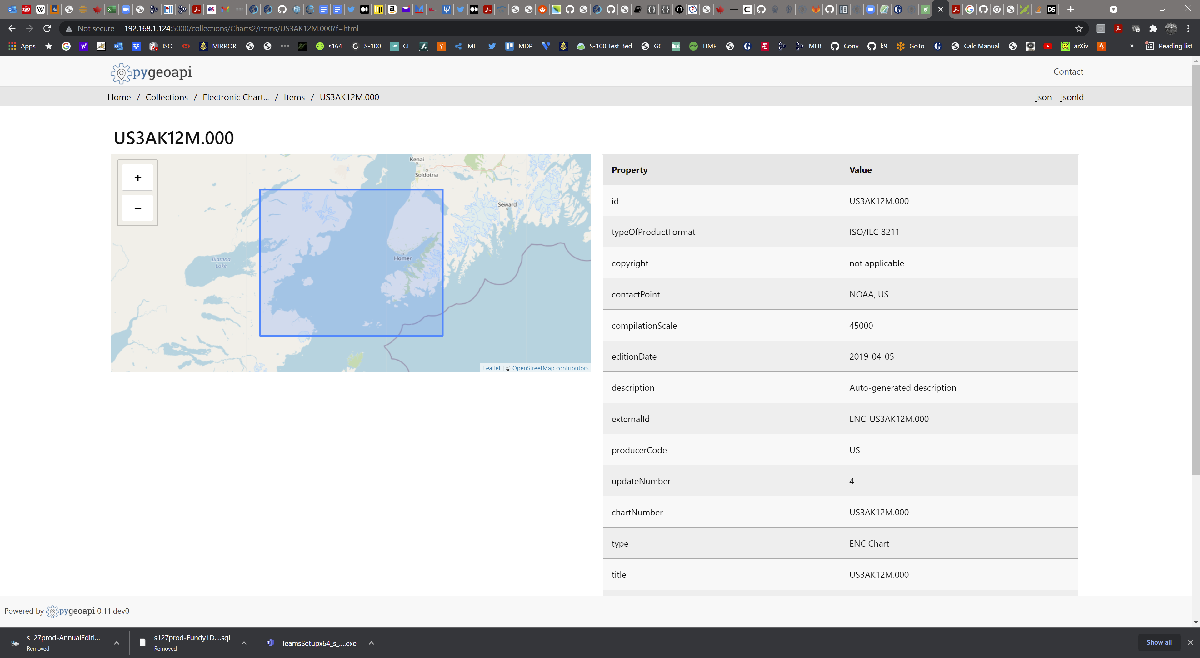
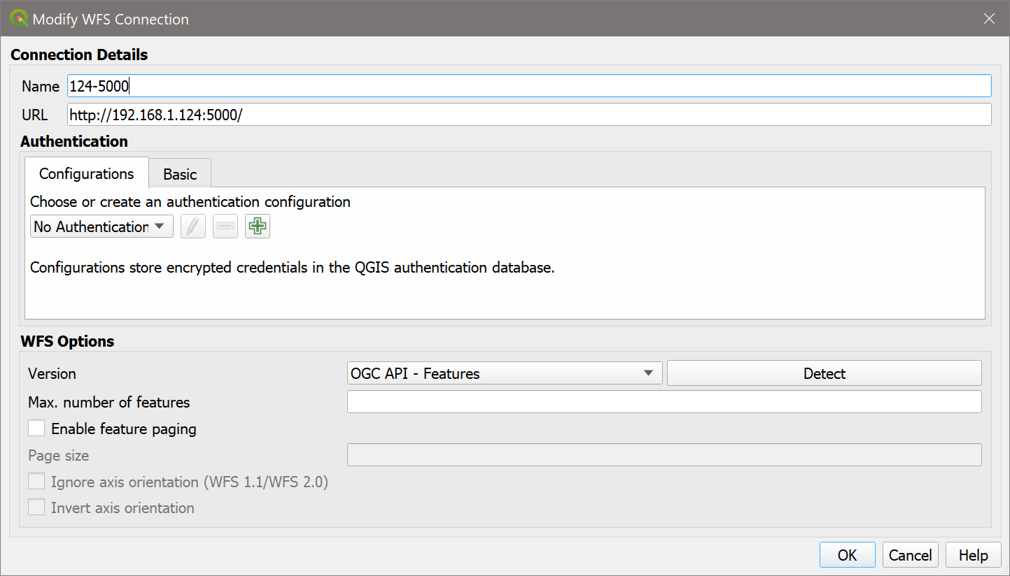
So… this begins to look a bit like a “pipeline”…
GeoJSON
output
ENC data
(s-57 for now)
PRODUCTS.TXT
(metadata file)
Extract Fields
Make OGC Records “feature”
(map fields)
S100DB
tinyDB Catalogue
pygeoAPI
(Records)
OGC API Records
Feature Catalogue

Slide 10
The Plan
Flesh out Metadata record structure for individual IHO data products
Model Other S-100 products where we have data to demonstrate
Map generic OGC API Records fields from IHO metadata (and data) for ENC
In addition to geoJSON extracts, transform IHO Feature Catalogue specs into OAS3 formats
Look deeper into enabling searching (and other enhancements) from pygeoapi
Broaden data (S-111 and S-102 are next)
Look more at discoverability
Best Practices doc
Enhance model. E.g. place names
Previous testbed initiatives
Establish persistent demo system
<S100XC:metadataFileIdentifier>111USA1_CBOFS_20211005T06Z_US4MD1AF.0001</S100XC:metadataFileIdentifier> <S100XC:metadataPointOfContact> <cit:CI_Responsibility> <cit:role> <cit:CI_RoleCode codeList="http://standards.iso.org/iso/19115/resources/Codelists/cat/codelists.xml#CI_RoleCode" codeListValue="publisher">publisher</cit:CI_RoleCode> </cit:role> <cit:party> <cit:CI_Organisation> <cit:name> <gco:CharacterString>NOAA</gco:CharacterString> </cit:name> </cit:CI_Organisation> </cit:party> </cit:CI_Responsibility> </S100XC:metadataPointOfContact> <S100XC:metadataDateStamp>2021-10-05</S100XC:metadataDateStamp> <S100XC:metadataLanguage>English</S100XC:metadataLanguage> <S100XC:S100_19115DatasetMetadata> <gcx:FileName src="MD_111USA1_CBOFS_20211005T06Z_US4MD1AF.XML" >MD_111USA1_CBOFS_20211005T06Z_US4MD1AF.XML</gcx:FileName> </S100XC:S100_19115DatasetMetadata> <S111XC:typeOfCurrentData>hydrodynamicModelForecast</S111XC:typeOfCurrentData> <S111XC:dataCodingFormat>regularGrid</S111XC:dataCodingFormat> <S111XC:methodCurrentsProduct>ROMS_Hydrodynamic_Model_Forecasts</S111XC:methodCurrentsProduct> <S111XC:minDatasetCurrentSpeed>0.0</S111XC:minDatasetCurrentSpeed> <S111XC:maxDatasetCurrentSpeed>0.98</S111XC:maxDatasetCurrentSpeed> </S111_DatasetDiscoveryMetadata>
S-111 Surface Currents Metadata.

Slide 11
Previous Slides.

Slide 12
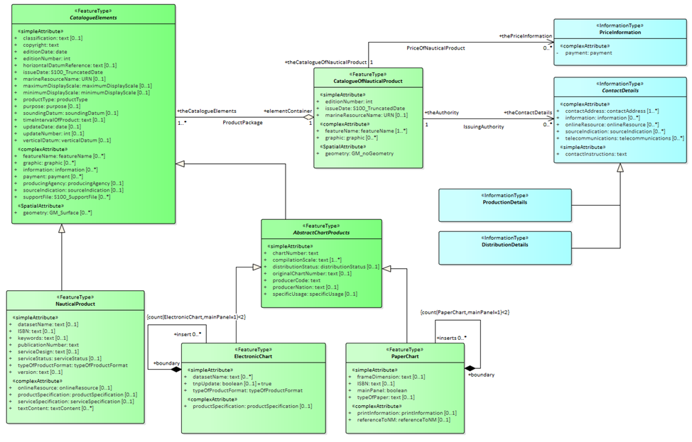
Some Background
IHO S-100 is a core standard for marine geospatial data in multiple domains and sectors.
Provides a framework for expressing arbitrary marine phenomena using a set of “product specifications”. These are composed of:
Formal model (UML)
Feature Catalogue (XML)
Encoding (currently GML, ISO8211 or HDF5)
Metadata is ISO19115 conformant (XML, with some mods)
IHO S-128 is a product specification which models common elements of metadata describing “services” and is used, primarily for service discovery. Specific to Maritime Data Services. Use Cases for ECDIS only
No formalised IHO->OGC mapping exists today, let alone at a framework (meta) or metadata level.
This project will deliver an S-128/S-100 metadata instance and make significant inroads into the generalised case
That’s the plan…. ☺

Slide 13
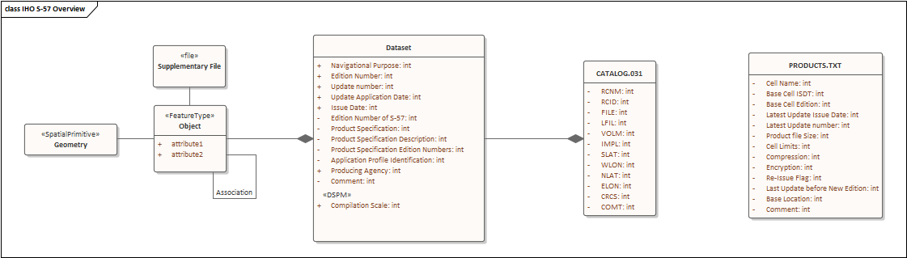
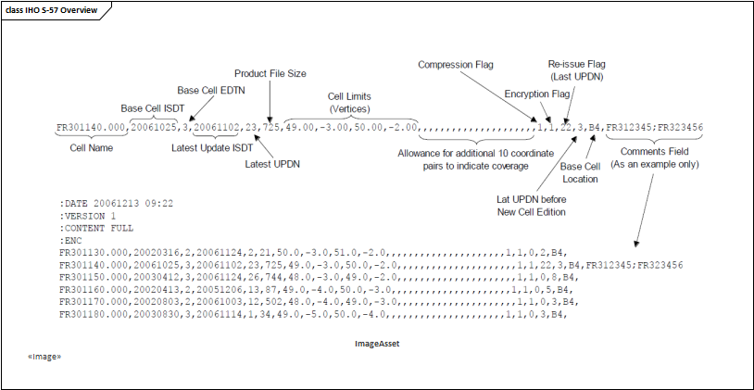
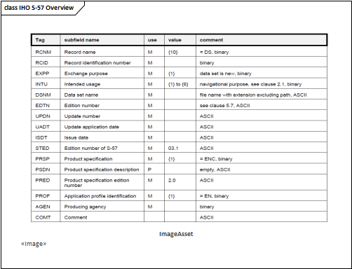
IHO S-100, the replacement for S-57. Edition 5.0.0 in preparation
Not yet approved for Navigation under SOLAS. In Development. Will replace data for Navigational Charts and Nautical Publications.
Multi-format, Vector, Gridded (HDF5), GML
Multi-Product (S-101, S-102, S-104, S-111 etc etc…)
Products have rigorous XML catalogues describing their content. IHO registry defines concepts
Data is “features” with “attributes” and “sub-attributes” aggregated into datasets, then into exchange sets and into a service.
Metadata
Cell Metadata – varies depending on encoding
CATALOG.XML ISO19115 conformant Exchange Set metadata
S-128 – Service metadata. “Catalogue of Catalogues”
IHO S-57 established since 2001
Data for existing Navigational Charts, ISO8211 format
“Objects” with “attributes” aggregated into cells, then into exchange sets and into a service.
Metadata
Cell Metadata DSID/DSPM records
CATALOG.031 Exchange Set metadata
PRODUCTS.TXT – Service data.
OGC API Records
Availability.

Slide 14
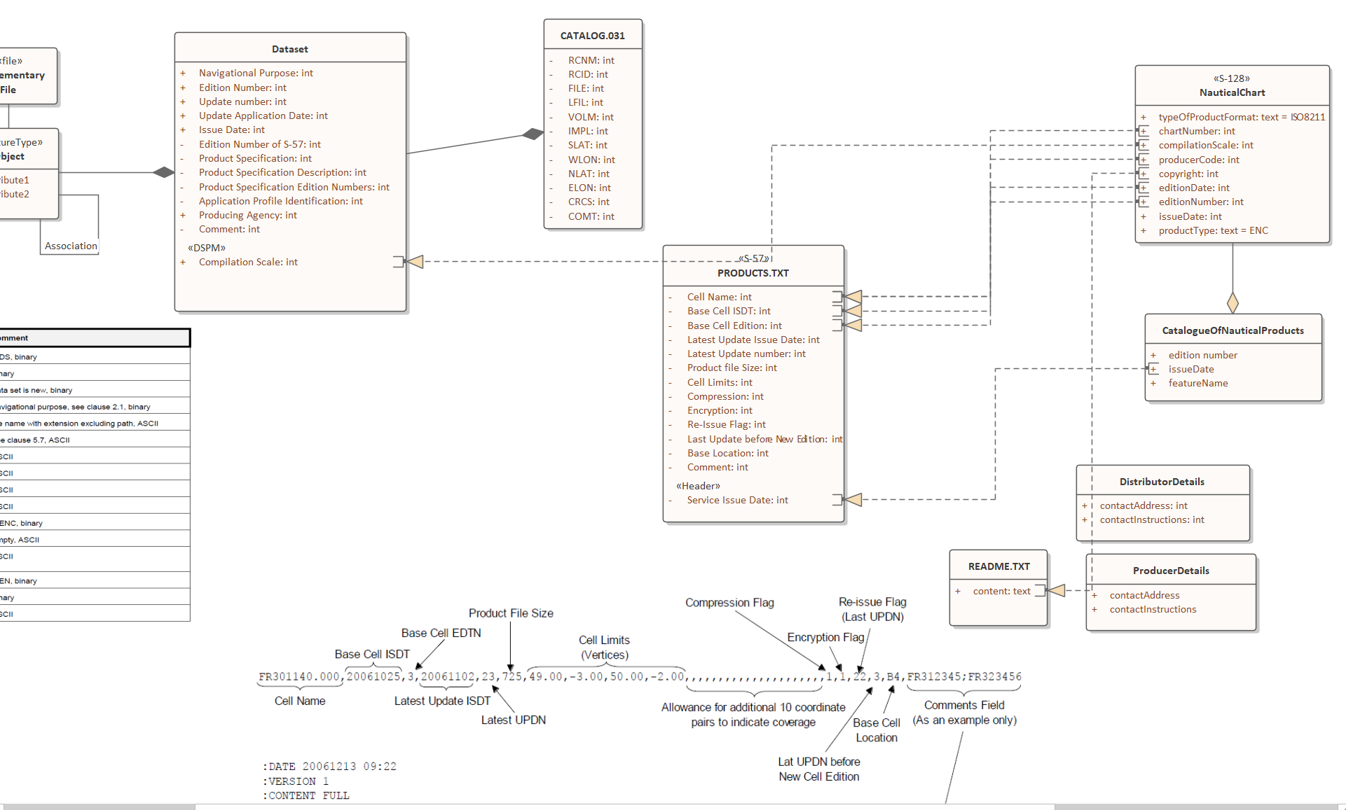
Ongoing Element Mapping:
S-57 to S-128 (Catalogue of Catalogues)
S-100 CATALOG.XML to S-128
IHO S-128 -> OGC API
CATALOG.XML (ISO19115) -> OGC API
Geometry Extraction (BBOX and COVR)

Slide 15
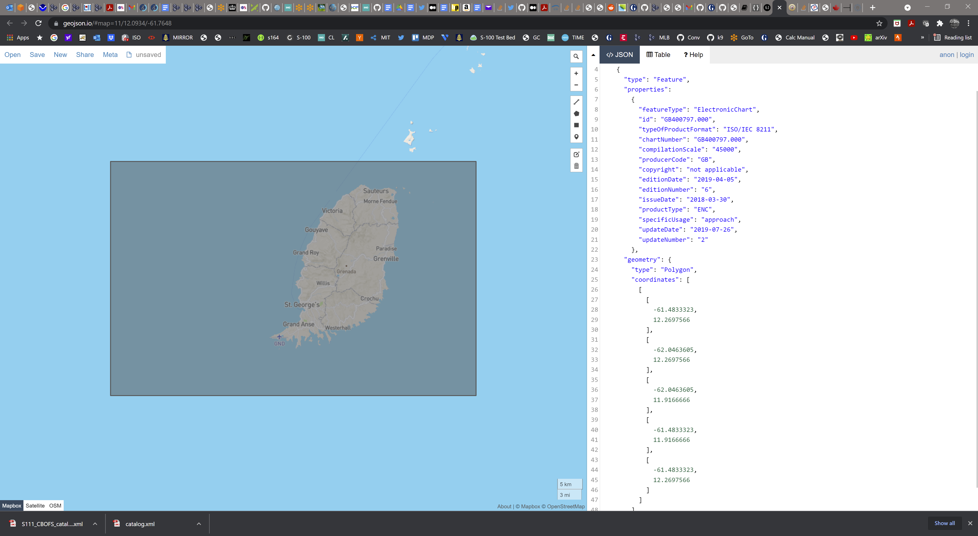
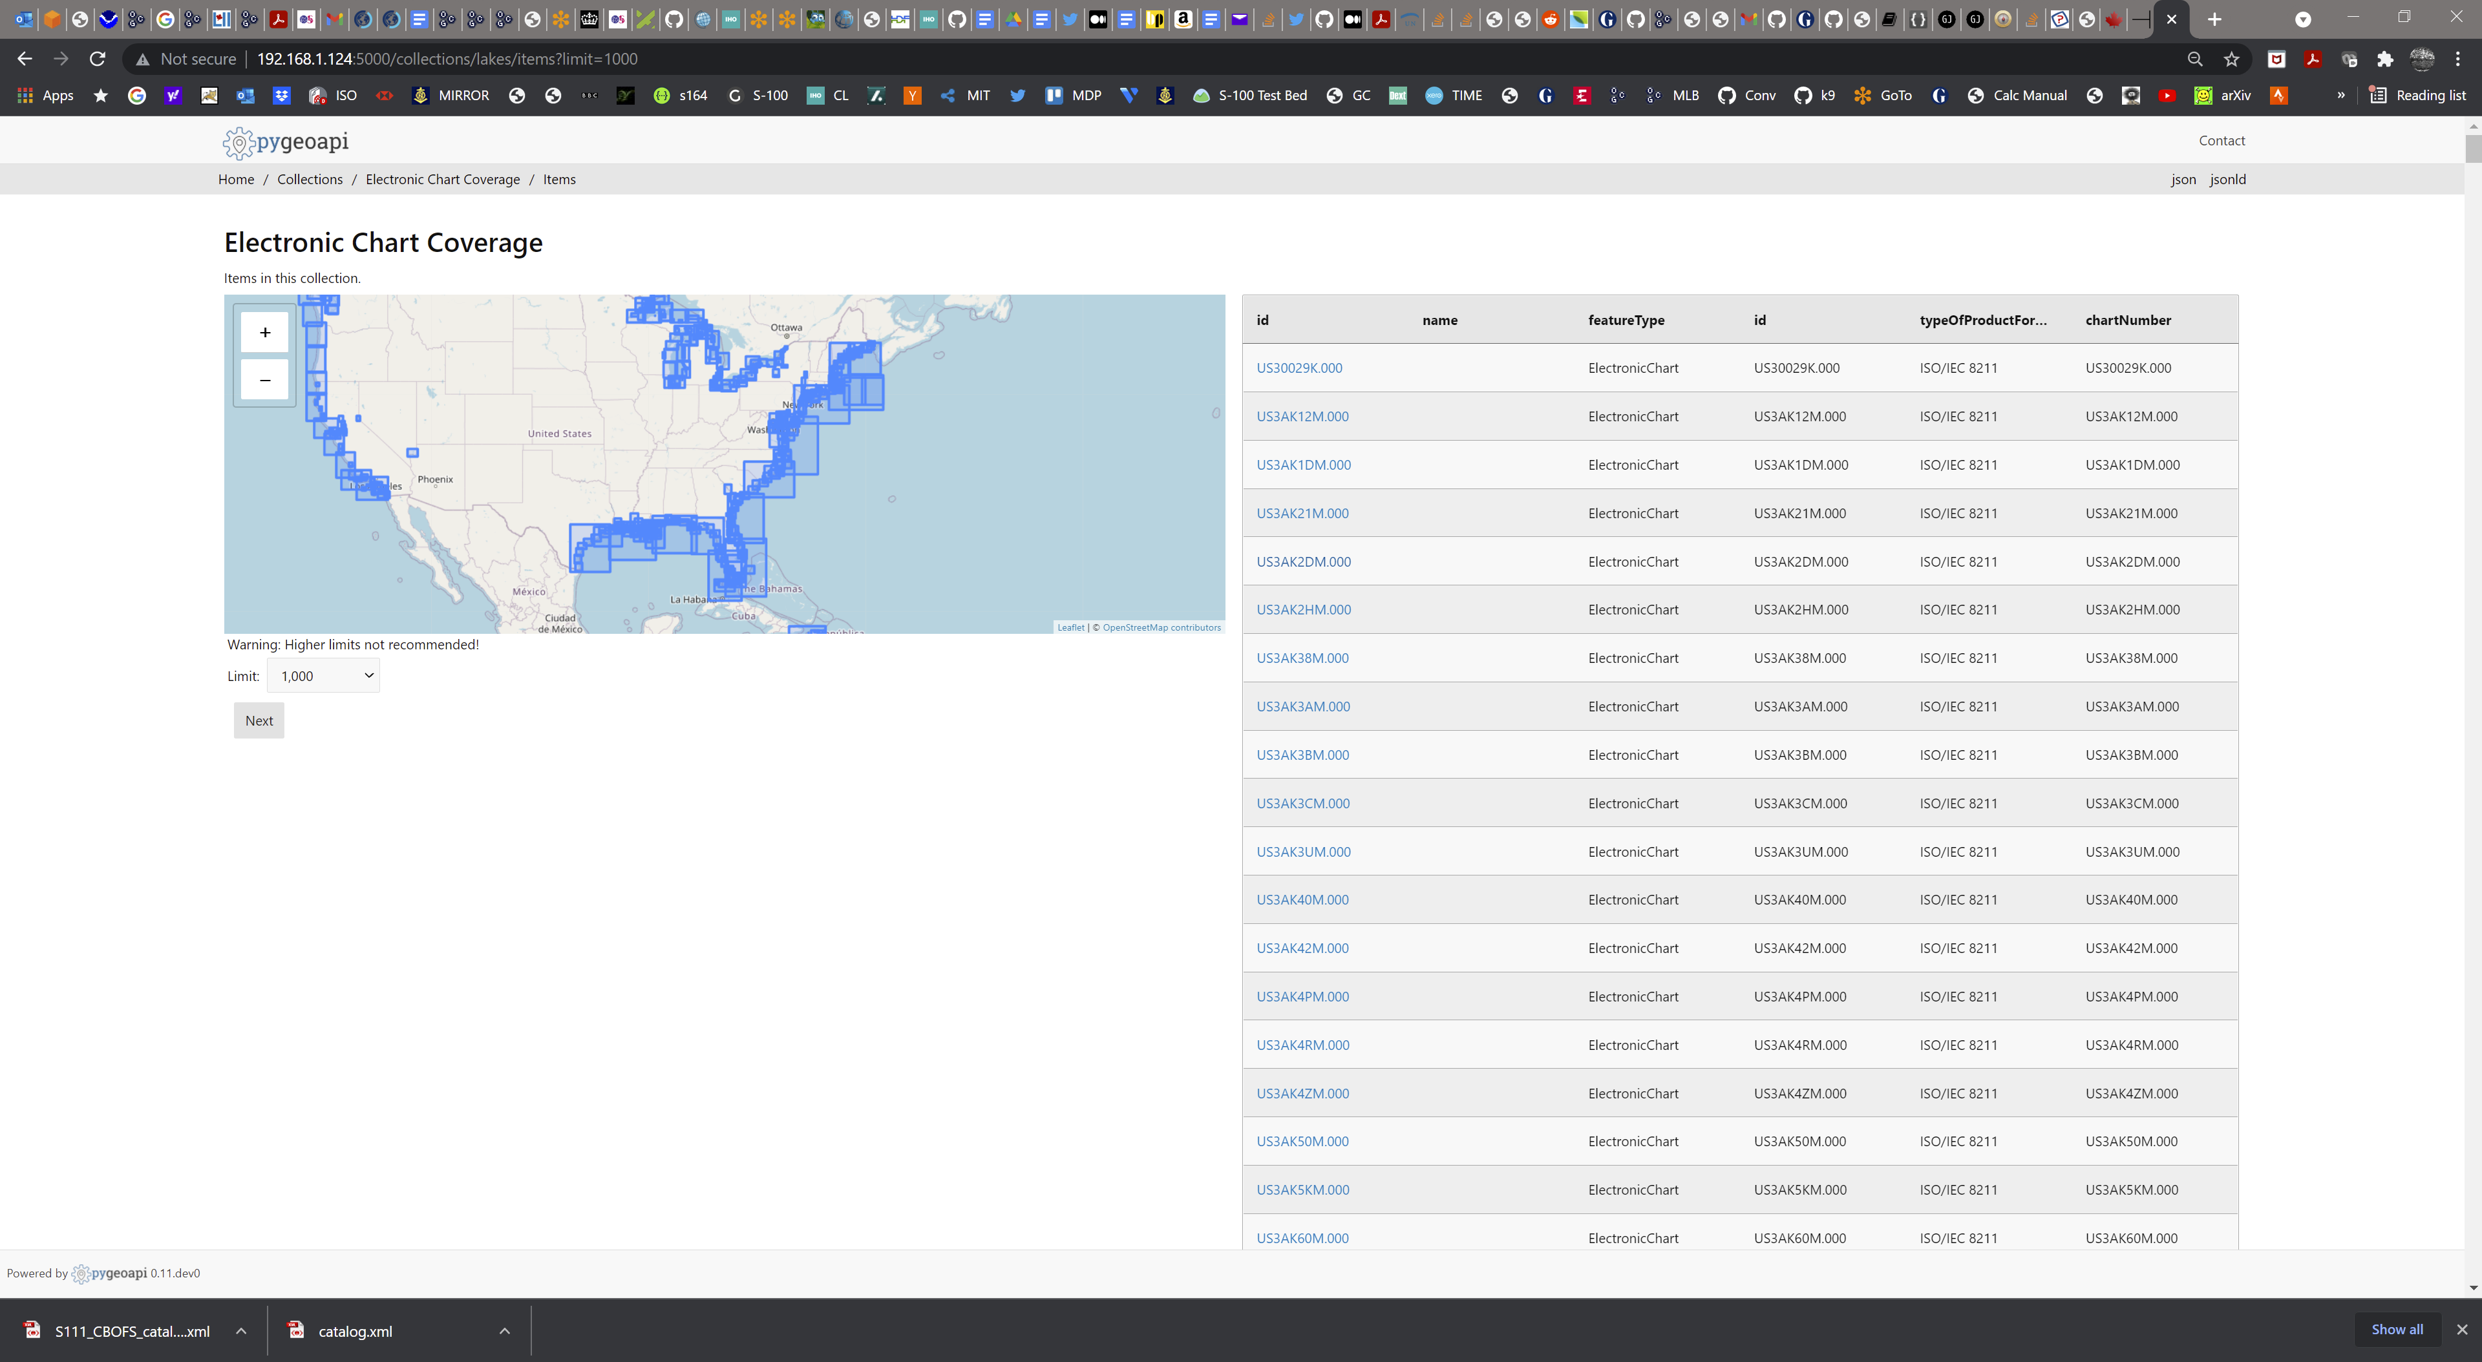
<?xml version="1.0" encoding="UTF-8" standalone="yes"?> <S128:Dataset xmlns:xsi="http://www.w3.org/2001/XMLSchema-instance" xmlns:S-127="http://www.iho.int/S127/gml/cs0/1.0" xmlns:xlink="http://www.w3.org/1999/xlink" xmlns:S128="http://www.iho.int/S128/gml/1.0" xmlns:S-123="http://www.iho.int/S123/gml/cs0/1.0" xmlns:S123="http://www.iho.int/S123/gml/1.0" xmlns:S-128="http://www.iho.int/S128/gml/cs0/1.0" xmlns:gml="http://www.opengis.net/gml/3.2" xmlns:S127="http://www.iho.int/S127/gml/1.0" xmlns:ns10="http://www.iho.int/s100gml/1.0" xmlns:ns12="http://www.iho.int/s100gml/1.0+EXT" gml:id="ID000"> <gml:boundedBy xsi:nil="true"/> <DatasetIdentificationInformation> <ns10:encodingSpecification></ns10:encodingSpecification> <ns10:encodingSpecificationEdition></ns10:encodingSpecificationEdition> <ns10:productIdentifier></ns10:productIdentifier> <ns10:productEdition></ns10:productEdition> <ns10:applicationProfile></ns10:applicationProfile> <ns10:datasetFileIdentifier></ns10:datasetFileIdentifier> <ns10:datasetTitle></ns10:datasetTitle> <ns10:datasetReferenceDate>2021-01-01</ns10:datasetReferenceDate> <ns10:datasetLanguage>en</ns10:datasetLanguage> <ns10:datasetTopicCategory>oceans</ns10:datasetTopicCategory> </DatasetIdentificationInformation> <member> <S128:ElectronicChart gml:id="US30029K.000"> <gml:boundedBy xsi:nil="true"/> <copyright>not applicable</copyright> <productType>ENC</productType> <issueDate>2013-09-26</issueDate> <updateNumber>0</updateNumber> <editionDate>2019-04-05</editionDate> <editionNumber>1</editionNumber> <chartNumber>US30029K.000</chartNumber> <compilationScale>45000</compilationScale> <specificUsage>approach</specificUsage> <producerCode>US</producerCode> <typeOfProductFormat>ISO/IEC 8211</typeOfProductFormat> </S128:ElectronicChart> </member>

Slide 16
Use Cases…
Data Providers
Make existing services searchable
Broader Use cases
Profiled datasets
Interoperability for third parties.
Multi-lingual
Others
Regulators
Regional / inter-agency
End users
Spatial Query (intersect with point, curve and surface)
Include large regions
Compilation scale (+usage?) + overlaps and selection
One or more Vertical datums
Feature inclusions
Query by producers, distributor
Commercial (e.g pricing)
Keyword (title?)
Product “purpose”

Slide 17
Plan of Action
Phase 1
Assessment of IHO Standards
S-128
S-100 Metadata Part 4a + dataset discovery metadata
Encodings, Schemas and Examples (simple?)
OGC Standards
API Features
API Records
Architecture
Reference Architectures
Examples
“Search”…
Phase 2
Implementation
Initial, simple using existing framework
S-100 specific implementation – Create or Adapt?
Technical Bottlenecks
OGC vs IHO GFM
Catalogues and Catalogues of Catalogues
IHO 19115 implementation
Mappings – types, date/times
Information Types
Relationships
Multi-Lingual
Implementation
Regions
US (data is free)
We can probably get UK, ROK, possibly DK, CA ask others
Formats – can ingest from ENC, also bespoke filters from IHO standard metadata can be written (existing and S-100 CATALOG.XML/CATALOG.031 and PRODUCTS.TXT)
“Search” and UI
What is the “best” way to test the project outputs and show users what has been developed?
Test…
ECDIS
User catalogues
Complex queries
Overlap Reporting and substitution
Outputs
IHO, Schemas and Product Specs (S-100 Main Document for edition 5.0.0 Early 2022), S-128 (for S-100 ECDIS, S-100 Governance Document)
OGC – outputs through MDWG for consideration of broader interoperability between IHO and OGC
Reference implementation for types and mappings of GFM

Slide 18
